Slide 1
Azure Storage

Slide 2
Agenda
Azure Storage Overview and Architecture
Premium Storage
Scalability Targets
Authentication and Access Control
Common Usage Patterns

Slide 3
Storage Lifecycle
Real time
Caching
Search
Near time
Long term
Time-based
Use-Based
Expiry based
Archive
Compliance
Compute
Video
Standard workloads
Size based
Backup
HPC
Database
High performance workloads
Event processing
Replication requirements
Low
Low
Medium
High
Cost
High
High
Medium
Low
Speed of access
High
Medium
Low
Low
R/W mix
Heavy R/W
Balanced (R/W)
Mostly R
R (on demand)

Slide 4
Key Foundational Storage Scenarios
Backup Files
Blob storage
IaaS (VMs)
Append Blobs
Log files
Page Blobs and Disks
Video Files
Block blobs
Unstructured data
Event messages
Queues
Manage structured data
SQL Database
SQL on IaaS
Table Storage
Other No-SQL storage
Document DB
Event Hubs
Cool storage
Archive storage
StorSimple
Azure backup
Azure Files
Hadoop
SQL Data Warehouse
Stretch Database
Azure Media Storage
Azure Site Recovery
Azure Backup
Data transfer
Import/Export
Notes:
Standard Storage
Block blobs
For streaming and storing documents, videos, pictures, backups, and other unstructured text or binary data.
File Storage
File Storage is now generally available. It uses industry standard SMB 3.0 protocol. Share files between applications running in your virtual machines using familiar Windows APIs or File REST API
Page Blobs & Disks
Optimized for random read and write operations, page blobs are ideal for VHD images.

Slide 5
Azure Storage Overview
Notes:
This section will be a very brief introduction of the core services offered in Azure Storage.

Slide 6
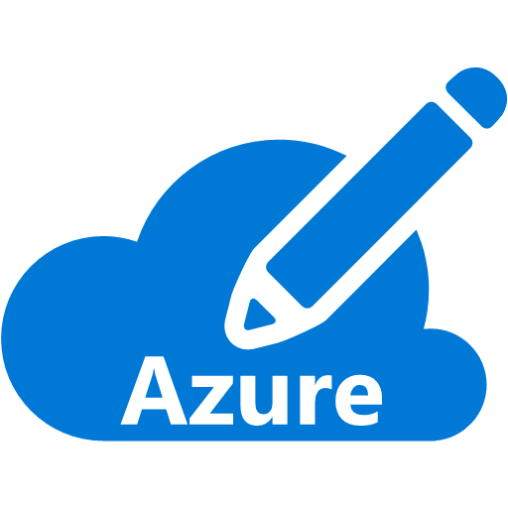

Azure Storage Accounts
An Azure Subscription can have up to 100 storage accounts.
Soft limit – contact support if you need more
Store up to 500TB per storage account
A storage account is uniquely addressable.
https://<account name>.<service name>.core.windows.net
Available from anywhere using REST API’s
Open source client libraries available for .NET, Native C++, Java, Android, Node.js, PHP, Python, Ruby, PowerShell, iOS
Storage Account
Storage Account
Storage Account
Max. 100 Storage Accounts
Notes:
An Azure subscription provides capacity for up to 100 storage accounts, each of which can store up to 500TB. So, you have basically 50 Petabytes of storage in a single subscription.
Each of your storage accounts have a globally unique DNS name. The structure of the DNS name is the name of your storage account, the service endpoint within the storage account (which we’ll cover in the next slide), followed by core.windows.net.
<click>
This means your data is accessible from anywhere using REST API’s and HTTPS. So, if you can speak REST then there are hundreds of REST API’s available that you can use to store and access your data.
If REST is not your thing, then consider the many language specific client libraries that Microsoft provides. These libraries are open source so you can see the code and even contribute to them if you like.
Azure Storage is a massively scalable service. For example, it processes over 6 million transactions per second. It stores over 50 trillion objects.

Slide 7
Storage Replication
Replication Strategy | LRS | ZRS* | GRS | RA-GRS
Data is replicated across multiple facilities | No | Yes | Yes | Yes
Data can be read from the secondary location as well as from the primary location | No | No | No | Yes
Number of copies of data maintained on separate nodes | 3 | 3 | 6 | 6
LRS – Locally Redundant
*ZRS - Zone Redundant (only for Block Blob)
GRS – Globally Redundant
RA-GRS – Read Access Geo Redundant
Notes:
We have also had questions about what types of data replication push data in what quantity, so here is a table representing the numbers across the types of replication.
For GRS When you create a storage account, you select the primary region for the account. The secondary region is determined based on the primary region, and cannot be changed.

Slide 8
Premium Storage

Slide 9
High Performance Storage for VM Workloads
Ideal for I/O intensive workloads
Supported with *S-Series VM (DS, GS, FS)
DS-Series can support up to 40 data disks
up to 64K IOPS and 960 MB/s
GS-Series can support up to 64 data disks
up to 80K IOPS and 2,000 MB/s
Notes:
https://azure.microsoft.com/en-us/documentation/articles/virtual-machines-windows-sizes/

Slide 10
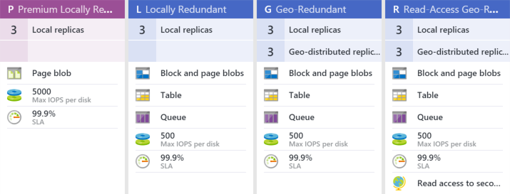
Premium compared to Standard Storage
Backed by SSD’s instead of HDD’s
Three sizes of disks available, 128GB (P10), 512GB (P20), and 1TB (P30)
IOPS per disk vary by size of disk: 500, 2300, and 5000
Throughput per disk varies by size: 100MB/sec, 150MB/sec, 200MB/sec
Storage costs incurred based on the size of the disk instead of amount of data
Storage analytics is not supported
Page Blob only (VHD)
Key pricing tip:
Standard=Pay for what you use
Premium=Pay for what you provision
Notes:
Reference
https://azure.microsoft.com/en-us/documentation/articles/storage-premium-storage-preview-portal/#pricing-and-billing-when-using-premium-storage
Azure Storage Analytics performs logging and provides metrics data for a storage account. You can use this data to trace requests, analyze usage trends, and diagnose issues with your storage account.
Storage analytics is not currently supported for Premium Storage. To analyze the performance metrics of VMs using disks on Premium Storage accounts, use the operating system based tools, such as Windows Performance Monitor for Windows VMs and IOSTAT for Linux VMs. You can also enable the Azure VM Diagnostics on Azure Preview Portal. Refer to Microsoft Azure Virtual Machine Monitoring with Azure Diagnostics Extension for details.

Slide 11
SQL Server on Premium Storage (Test Results)
DS14 VM (16 cores, 112GB RAM, 10 P30 data disks)
The cache on the VM is 576 GB
Database with ~750GB data
Single table with 7.2 billion rows
Single clustered index
Operation | Execution Time | Throughput (MB/Sec)
Full Restore | 49 min | 266
Full Backup | 52 min | 249
Index Scan select count * | 25 min | 470
Drop Index (Clustered) | 23 min | 525
Create Index (Clustered) | 99 min | 252
CheckDB | 54 min | 269
Up to 140% faster than competition

Slide 12




Azure Storage Account Services
Blobs
File Shares
Block: Text or binary data (.log, .exe, .jpg, etc.).
Up to 200GB.
Page: Optimized for disks (.vhd). Supports random read-write. Up to 1TB.
Supports SMB 3.0 protocol.
Can be accessed like a traditional file share.
Share files between multiple Virtual Machines.
A single file share can be up to 5TB.
Append Blob: Writes to end of the blob (4MB max) up to 50k times (~195GB)
Tables
Queues
NoSQL storage of structured data (entities).
Key/value storage.
A single entity can have up to 255 properties and be up to 1MB.
Durable messaging.
Provides asynchronous communication between application tiers and components.
A single message can be up to 64KB.
Notes:
There are 4 services in an Azure Storage account. The first we will cover is the Blob service. The blob service supports two types of blobs, block blobs and page blobs. Block blobs are used for streaming content and storage of text or binary data. Essentially anything you want to store in it. The size limit for a single block blob is 200GB.
Page blobs are optimized for random read/write operations. Disks that are used to back Azure Virtual Machine’s use page blobs. The size limit for a single page blob can be 1TB.
They managed in containers. Containers allow you to group blobs together.
Block blobs are for sequential reads. Read or write at one time like photos. logs, files
Page blobs are for random reads. 3 copies in the same region. This is what backs the VM service and VM storage.
There is also a new blob type called append only blob. An append blob is comprised of blocks and is optimized for append operations. When you modify an append blob, blocks are added to the end of the blob only, via the Append Block operation. Updating or deleting of existing blocks is not supported. Unlike a block blob, an append blob does not expose its block IDs.
Each block in an append blob can be a different size, up to a maximum of 4 MB, and an append blob can include up to 50,000 blocks. The maximum size of an append blob is therefore slightly more than 195 GB (4 MB X 50,000 blocks).
<click>
The File service is a new service in preview that supports the SMB protocol. This allows you to access Azure Storage like you would a traditional file share. It also enables you to share files between multiple Virtual Machines, which is not something you can do with a disk.
Once created, you can mount the SMB share just like a regular file share
<click>
The Table service provides extremely fast storage of structured data. It is a NoSQL storage solution – don’t confuse it with SQL tables (not even close). It is a key/value storage solution. When using Azure Tables, think of “entities”. An entity can have up to 255 properties associated with it, which includes 3 system properties required by the service. And a single entity cannot exceed 1MB.
Really flexible storage.
<click>
The Queue service provides a durable messaging store that can be used for asynchronous messaging between application tiers or components. FIFO is typical, but not guaranteed. If you need a more robust messaging system than the Azure Service Bus should be considered. For simple messaging requirements, Azure Queues is extremely effective.

Slide 13
Azure Storage Concepts
Account
(Blobs) Container
Table
File shares
Queues
Blobs
Entities
Directories/Files
Messages
Notes:
In Azure, you have 4 abstractions of storage. each of those 4 abstractions have objects based on the type of data you are storing.
A standard storage account gives you access to Blob storage, Table storage, Queue storage, and File storage:
Blob storage stores file data. A blob can be any type of text or binary data, such as a document, media file, or application installer.
Table storage stores structured datasets. Table storage is a NoSQL key-attribute data store, which allows for rapid development and fast access to large quantities of data.
Queue storage provides reliable messaging for workflow processing and for communication between components of cloud services.
File storage (Preview) offers shared storage for legacy applications using the standard SMB 3.0 protocol. Azure virtual machines and cloud services can share file data across application components via mounted shares, and on-premise applications can access file data in a share via the File service REST API. File storage is available by request via the Azure Preview page.
Each standard storage account can contain up to 500 TB of combined blob, queue, table, and file data. See the Azure Storage Scalability and Performance Targets for details about standard storage account capacity.
The image below shows the relationships between the Azure storage resources in a standard storage account

Slide 14
Azure Storage Introduction
Notes:
1_Storage_Introduction.docx
In this demo, we will introduce you to the different storage options, tiers and configurations. We will come back and show you more in a later demos.
The demo will show the options, the tiers, where to access them from the portal and also how they are used.

Slide 15
Azure Storage Architecture

Slide 16
Azure Storage Architecture (3 tiers)
Front End Layer (auth, requests, metering/throttling, validation)
FE 1
FE 2
Partition Layer (enables batch transactions and consistency)
Partition 1
(A-C)
Partition 2
(D-E)
Partition 3
(F-J)
Partition 4
(K-T)
Stream Layer (replicas of data)
Stream 1
Stream 2
Stream 3
Stream 4
Stream 5
Notes:
Front-End (FE) layer – The Front-End (FE) layer consists of a set of stateless servers that take incoming requests. Upon receiving a request, an FE looks up the AccountName, authenticates and authorizes the request, then routes the request to a partition server in the partition layer (based on the PartitionName).
Partition Layer – The partition layer is built for a few things:
managing and understanding higher level data abstractions (Blob, Table, Queue)
providing a scalable object namespace
providing transaction ordering and strong consistency for objects
storing object data on top of the stream layer
caching object data to reduce disk I/O. Another responsibility of this layer is to achieve scalability by partitioning all of the data objects
A single partition is served by a single partition server, therefore, the scale of a partition is limited to what the partition server can handle. Partitions are extremely important to understand and can often be the difference between a poorly performing system and a well performing one.
Stream Layer – This layer stores the bits on disk and is in charge of distributing and replicating the data across many servers to keep data durable within a storage stamp.

Slide 17
Azure Storage Partitions
Partition is a scale mechanism for storage
A partition is served by a partition server
The scale of a partition is limited to what the partition server can handle
Data in same partition can be updated in an atomic manner. For example,
Update a list of blocks in a blob and commit together
Add/Update/Delete entities in a table as part of a transaction
Write a batch of messages to a queue
Data in separate partitions can be load balanced across partition servers.
Notes:
What you should take away from the previous few slides is the critical path for which data is served through a partition server.
Think of partitions as the first place Azure looks to distribute the data and load balance. In a logging scenario for example if you use date, the same date cannot be split. This causes a “hot partition” and may be subject to throttling.
A partition is serviced by a partition server. Therefore, the scale of a partition is limited to what the partition server can handle. We’ll get into some of those limits shortly when we talk about scalability targets.
This leads to a couple of design considerations when you are building your solution. First, data that is in a single partition can be updated in a single atomic operation. This enables things like adding, updating, and deleting multiple rows in a table that have the same partition key all at once. Either all the adds, updates, and deletes are applied or none of them are. This provides consistency for your data.
The other design consideration is that data in separate partitions can and are load balanced by Azure Storage across multiple partition servers.
So, when you are designing your data think about how you will use the data and therefore how to define your partition keys.
https://azure.microsoft.com/en-us/documentation/articles/storage-scalability-targets/ See the Partition in Azure Storage section at the bottom of page
Which leads to the next slide….

Slide 18


Blob Storage Container Concepts
https://storageaccountname.blob.core.windows.net/CONTAINERNAME
VHDs
Container 3 (/Public)
/Win2k12-datacenter.vhd
Container 1 (/VHDs)
/Pic1.jpg
/Videos
Container 2 (/Logs)
/Log1.log
/Photos
/MyVideo.mp4
Partition Key=blobname
Notes:
Storage Account – All access to Windows Azure Storage is done through a storage account.
This is the highest level of the namespace for accessing blobs
An account can have many Blob Containers
Blob Container – A container provides a grouping of a set of blobs. The container name is scoped by the account.
Sharing policies are set at the container level, where a container can be set to private or to be publically accessible. When a container is set to Public, all its contents can be read by anyone without requiring authentication. When a container is Private, authentication is required to access the blobs in that container.
Containers can also have metadata associated with them. Metadata is in the form of <name, value> pairs, and they are up to 8KB in size per container.
The ability to list all of the blobs within the container is also provided.
Blob – Blobs are stored in and scoped by Blob Containers. Blobs can have metadata associated with them, which are <name, value> pairs, and they are up to 8KB in size per blob. The blob metadata can be set and retrieved separately from the blob data bits.
Can we folders and logical structures? The answer is kind of. Securing by Container and separating by folders

Slide 19
Table Storage Concepts
https://storageaccountname.table.core.windows.net/TABLENAME/
Partition Key = Last Name (Example)
lastname1
lastname2
Entity1
Att1 = value
Entity2
Key=userid
Att1 = value
Att 2 = value
Entity3
Key=userid
Att1 = value
Att 3 = value
Att 3 =value
Att 6 = value
Key=userid
Partition Key=LASTNAME1
Partition Key=LASTNAME1
Partition Key=LASTNAME2
Partition Key=lastname
Notes:
Storage Account – All access to Windows Azure Storage is done through a storage account.
This is the highest level of the namespace for accessing tables
An account can have many Tables
Table – contains a set of entities. Table names are scoped by the account. An application may create many tables within a storage account.
Entity (Row) – Entities (an entity is analogous to a "row") are the basic data items stored in a table. An entity contains a set of properties. Each table has two properties, “PartitionKey and RowKey”, which form the unique key for the entity.
An entity can hold up to 255 properties
Combined size of all of the properties in an entity cannot exceed 1MB. This size includes the size of the property names as well as the size of the property values or their types.
Property (Column) – This represents a single value in an entity. Property names are case sensitive.
PartitionKey – The first key property of every table. The system uses this key to automatically distribute and load balance the table’s entities over many servers.
RowKey – A second key property for the table. This is the unique ID of the entity within the partition it belongs to. The PartitionKey combined with the RowKey uniquely identifies an entity in a table.
Timestamp – Every entity has a version maintained by the system. This is used for optimistic concurrency.
Sort Order – There is a single index for Windows Azure Tables, where all entities in a table are sorted by PartitionKey and then RowKey. This means that queries specifying these keys will be more efficient, and all results are returned sorted by PartitionKey and then by RowKey.
Types – PartitionKey and RowKey must be of type string and the rest of the properties can be any of the following types: Binary, Bool, DateTime, Double, GUID, Int, Int64, String.
No Fixed Schema – No schema is stored by Windows Azure Table, so all of the properties are stored as <name, typed value> pairs. This means that two entities in the same table can have very different properties. A table can even have two entities with the same property name, but different types for the property value. However, property names must be unique within a single entity.

Slide 20
Queue Storage Concepts
https://storageaccountname.queue.core.windows.net/QUEUENAME/
Queue (Order Processing)
Order1
Order2
OrderN…
Partition Key=queuename
Notes:
Storage Account – All access to Windows Azure Storage is done through a storage account.
This is the highest level of the namespace for accessing queues
An account can have many Queues
Queue – A queue contains many messages. The queue name is scoped by the account.
There is no limit on the number of messages stored in a queue (the only limit is the 100TB size limit on the storage account).
A message is stored for at most a week. The system will garbage collect the messages that are more than a week old.
Queues can have metadata associated with them. Metadata is in the form of <name, value> pairs, and they are up to 8KB in size per queue.
Messages – Messages are stored in queues. Each message can be up to 8KB in size. To store larger data, one can store the data in Azure Blob store or Azure Table store, and then store the blob/entity name in the message. Note that when you put a message into the store, the message data can be binary. But when you get the messages back from the store, the response is in XML format, and the message data is returned as base64 encoded.

Slide 21
Files Storage Concepts
file:\\storageaccountname.files.core.windows.net\SHARENAME
Share name 1 (archive)
/Folder
/File1.docx
/foldera
/file2.pptx
/folder
/folder
Files
Share name 1 (S Drive)
/Folder
/File1.docx
/foldera
/file2.pptx
/folder
/folder
files
Partition Key=sharename
Notes:
Storage Account: All access to Azure Storage is done through a storage account. See Azure Storage Scalability and Performance Targets for details about storage account capacity.
Share: A File storage share is an SMB file share in Azure. All directories and files must be created in a parent share. An account can contain an unlimited number of shares, and a share can store an unlimited number of files, up to the 5 TB total capacity of the file share.
Directory: An optional hierarchy of directories.
File: A file in the share. A file may be up to 1 TB in size.
URL format: Files are addressable using the following URL format: https://<storage account>.file.core.windows.net/<share>/<directory/directories>/<file>
The following example URL could be used to address one of the files in the diagram above: http://samples.file.core.windows.net/logs/CustomLogs/Log1.txt
This means all files in a file share are also in a single partition

Slide 22
Azure Files
Notes:
2_Storage_FileShare.docx
Create a new file share, copy and paste the net use statement and mount it locally. Add a file and then view it locally.

Slide 23
Scalability Targets
Notes:
Now that you understand the architecture behind Azure Storage and realizing that there are limits in every system, let’s discuss what these limits are and where they exist in the architecture.

Slide 24
Scalability Targets – Standard Storage
Standard Storage Account: 20,000 IOPS
Blobs
File Shares
500 IOPS or 60MB/s on Standard Storage.
Basic/Standard Tier VM: 300/500 IOPS/disk.
1,000 IOPS or 60MB/second (8K object size).
Tables
Queues
2,000 Entities/second (1K entity size)
2,000 Messages/second (1K message size).
Notes:
A single standard storage account is capable of 20,000 IOPS for the entire storage account. So, as you use the various service abstractions keep this limit in mind. For example, if you have 20 virtual machines, each with 2-3 attached disks, then you could potentially be throttled if all the virtual machines are peaking at the same time.
Question: What would you do if you found you were exceeding the IOPS for your account?
Answer: Create another storage account and shift the storage for some of your workloads to the new storage account. Remember, you can have up to 100 storage accounts per subscription. Contact support if you need more than that.
For blobs, you are talking about page blobs and the limits for these will vary based on the pricing tier of the VM. As an example, for each attached disk on a Standard VM, you will get up to 500 IOPS per disk.
Question: If you attach three 1TB data disks to a virtual machine and then stripe the disks in the Virtual Machine to create one 3TB drive, what would be the scalability target for that drive in the virtual machine?
Answer: Up to 1,500 IOPS. Remember, the 500 IOPS is per blob. Even though it looks like one single drive to the VM, it is backed by 3 separate blobs and as you saw earlier, these are load-balanced across partitions.
Continuing, you can see what the scalability targets are fro the other storage services.
Question: If you need to handle more than 2,000 messages per second in a queue, how can you do this?
Answer: Create another queue. You can have as many queues as you need. So, you may have a queue for one type of message and another queue for another type of message. Leverage both queues from your application.

Slide 25
Scalability Targets – Premium Storage
Premium Storage Account: 50 Gbps
Blobs (Disks)
500 -5000 IOPS (P10 – P30)
100MB/s -200MB/s throughput (P10 – P30)
GS5 VM: 80.000 IOPS, 2.000 MB/s throughput
Notes:
A single premium storage account is capable of 50 GBps throughput for the entire storage account, and holds up to 35TB of data.
If you only use P10 disks at 128GB each, you can put maximum 280 disks on a single Premium Storage account, or 35 P30 disks at 1023GB each. There are no limitations on IOPS, and you should under no circumstances hit the throughput limitation of 50GBps
Further details
https://azure.microsoft.com/en-us/documentation/articles/storage-scalability-targets/
https://azure.microsoft.com/en-us/documentation/articles/virtual-machines-linux-sizes/

Slide 26
Scalability Targets
Notes:
3_Storage_Disk_IOPS.docx

Slide 27
Authentication and Access Control

Slide 28
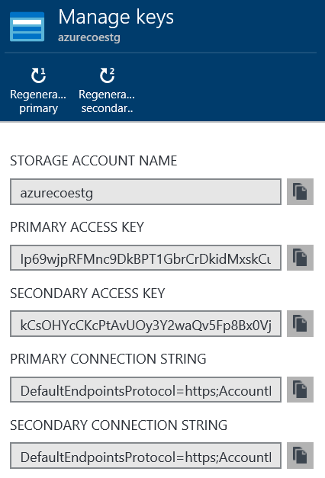


Storage account security
A storage account is protected by an access key
The storage account name and access key collectively are used to authenticate to the account
The access key gives you full access to the storage account
RBAC is an effective way to limit this.
Rotate access keys regularly
Authentication
Acct Name + Key
Client
Web App
Storage Account
Notes:
When you create a storage account you must provide a unique name. During account creation Azure will generate a set of access keys for your storage account. Collectively, the storage account name and an access key provide the credentials you need to authenticate and access objects in your storage account.
By default, access keys give you full control of the storage account and allows you to do virtually anything you want in the account. Therefore, it is a security best-practice to regenerate your access keys periodically.
Question: Notice in the screen capture here there are two access keys generated; a primary and a secondary. Would anyone care to guess why there are two?
Answer: As mentioned previously, it is a security best practice to regenerate your keys regularly since these keys give you essentially full access to the account. There are two keys associated with the storage account for HA reasons. The idea is simply this… suppose you have web applications and virtual machines that use Azure storage for various activities. Also assume that the applications are currently using the primary access key. If you regenerate the keys for the storage account you will break those applications. So, the intent here is to first notify application owners to update their applications to use the secondary access key. After the applications are updated, then you can regenerate the primary access key. After 30 days or so, repeat the process but this time have the application owners switch back the primary access key.
Also, note that this notion of two access keys is not unique to Azure storage. You will see this in other parts of the platform such as Service Bus, Media Services, and others. So, when you see this understand that this is how the two keys are intended to be used.
Finally, as the graphic at the bottom of the screen shows, typically applications will be the primary consumers of the access keys. Or, it could be a management tool that you use to manage your azure storage account. You never want to give these keys to clients or end-users.

Slide 29
Shared Access Signatures (SAS)
A URI containing information to grant limited or full access to objects in your storage account
SAS tokens identify a resource, start time, stop time, and permissions
Access policies can be used for resource containers
Blob container, File Share, Table, Queue
Authentication
Username + Password
Authentication
Acct Name + Key
Client
SAS Token
Web App
Storage Account w/CORS
Read/Write using SAS
Notes:
A common architecture for a web app is one where data is proxyed through the web application instance. For example, if I want to retrieve data then a request is made to the web app, which in turn retrieves the data from storage, and then responds to the client with the data. For small data this is generally not a problem. However, as the size of the data grows it is often times necessary to scale up and/or out the web application to support user demand.
A better approach could be to offload R/W operations to storage such that the client directly accesses the storage. This is where SAS tokens can be extremely useful. When the client requests to read/write data, the web application instead returns a SAS token that contains the information necessary to authenticate access to a resource in storage.
In this scenario, a client authenticates to the web application as usual using a set of credentials. When the authenticated user does something on the site that requires a R/W operation on data, the site returns a SAS token to the client and then client performs the operation directly against storage using the SAS token to authenticate against the storage service.
Not stored, they are computed on the fly. Can store a stored access policy on containers
Improvements made (HTTPS only, Account SAS and IP ACL SAS)
Reference
https://azure.microsoft.com/en-us/documentation/articles/storage-dotnet-shared-access-signature-part-1/

Slide 30
Architecture Patterns using Storage

Slide 31
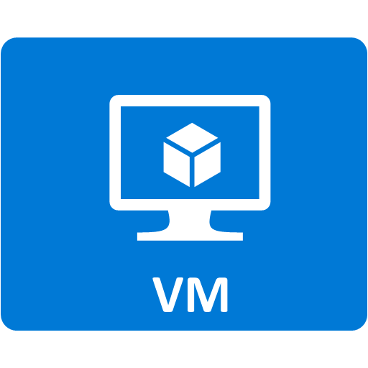
Use separate storage accounts for high performance workloads
SQL Server Workload
IIS Web Farm
SAP on Azure
Storage Acct 1
(20K IOPS)
Storage Acct 2
(20K IOPS)
Storage Acct 3
(20K IOPS)
Notes:
Max 40 disks per account
Up to 100 storage accounts per subscription

Slide 32



Use separate storage accounts for logging
App Messaging & Storage
Storage Acct 1
Client
App Service
Logging & Diagnostics
Storage Acct 2

Slide 33



Use queues to improve application scale
Scale-out tiers independently
Client
Queue
Web Apps
Databases
Web Jobs
(Background Processing)
Notes:
The use of queues decouples different parts of the application, making it easier to scale each part independently. This allows the number of web and worker roles to be adjusted without affecting the application logic.
Separate queues can be used for work items of different priorities and/or different weights, and separate pools of back-end servers can process these different queues. In this way, the application can allocate appropriate resources (e.g. the number of servers) in each pool, efficiently using the available resources to meet the traffic needs of different characteristics.

Slide 34
Summary
Azure Storage Overview and Architecture
Premium Storage
Scalability Targets
Authentication and Architectural Patterns

